Slide 1
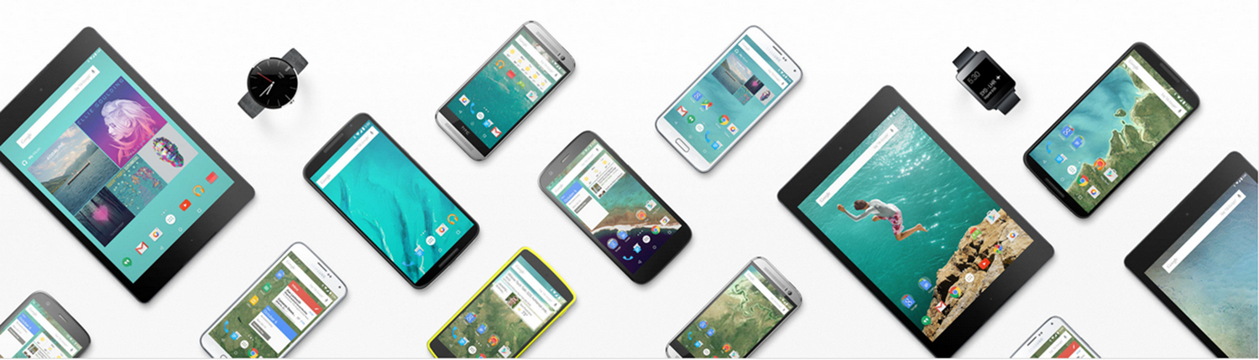
PRESENTATION
Qinyuan.Fan sep.2015

Slide 2
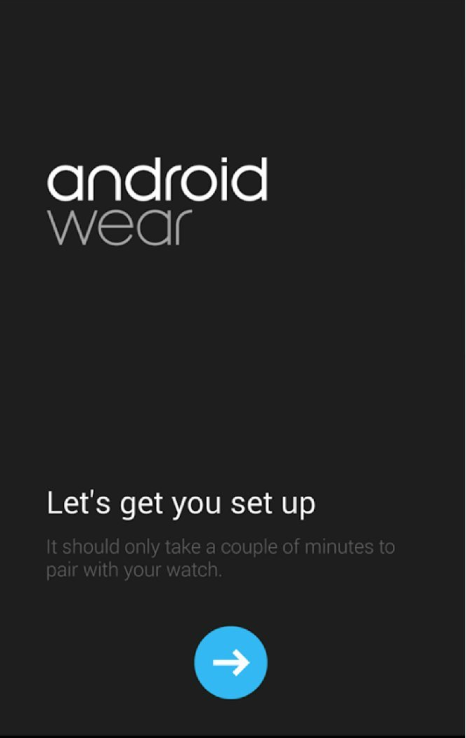
For a long time, iOS and Android dominate(主宰着） our Smartphones . they both have a long history. And their company-apple&google have released many products. Now, let’s recall the history of them.

Slide 3
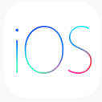
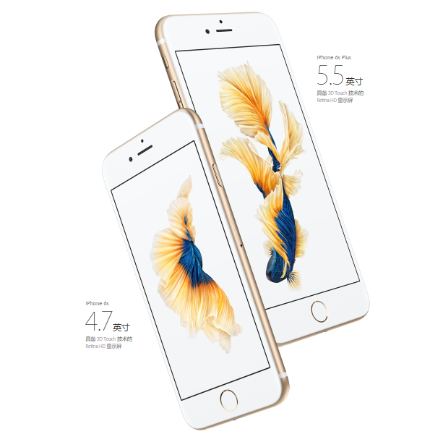
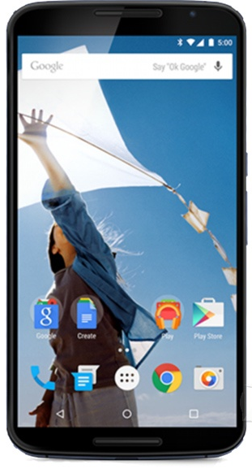
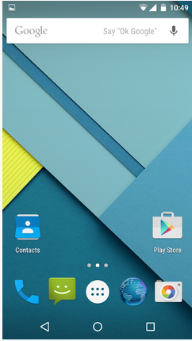
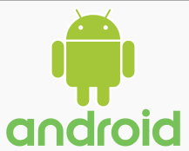
Android or IOS?

Slide 4
iOS (originally iPhone OS) is a mobile operating system created and developed by Apple Inc. and distributed exclusively for Apple hardware. It is the operating system that presently powers many of the company's mobile devices, including the iPhone, iPad, and iPod touch.

Slide 5
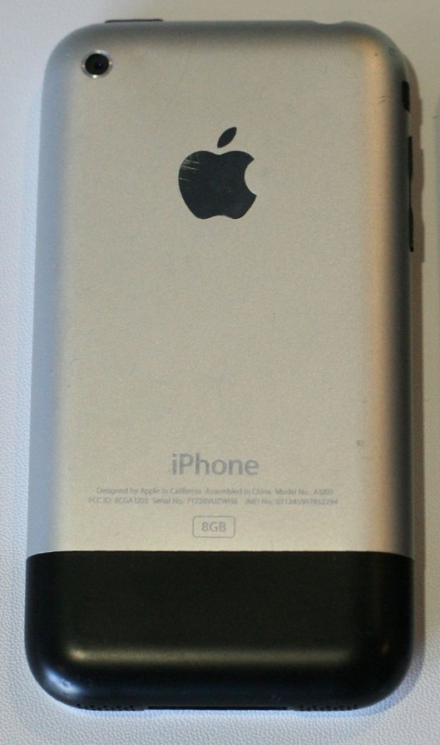
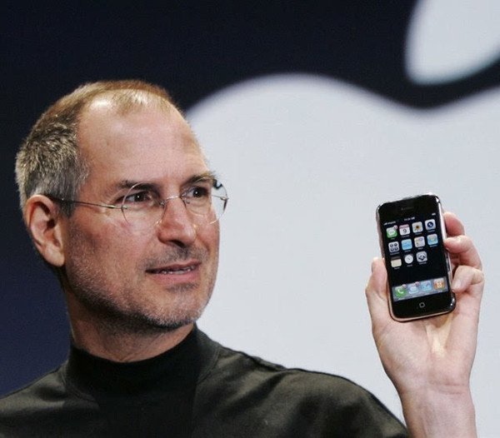
iphone2
It is hard to imagine that the first version of the iPhone could not download apps, send e-mail, listen to music and so on. It is only a Touch-screen phone that can access the internet.
Even that, the first iPhone allowed people crazy.

Slide 6
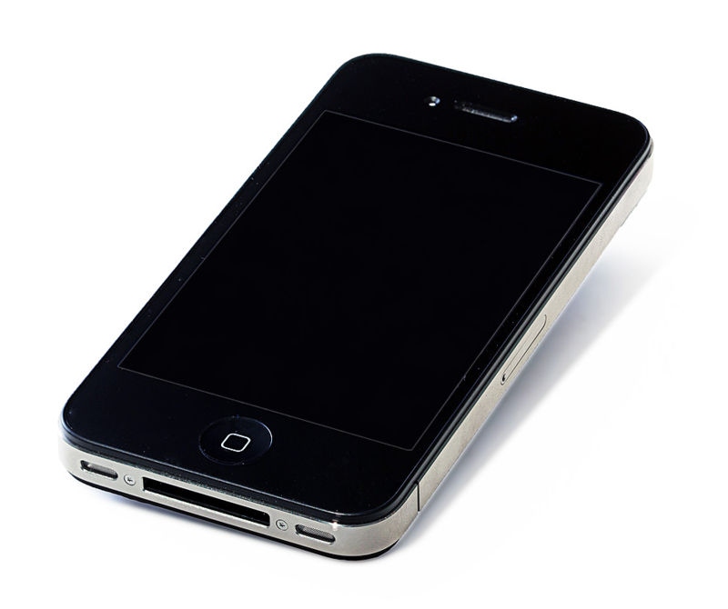
IPhone 4
iphone4 is a landmark work. The multi-tasking capabilities（多任务）was added. Jobs also added the Front Camera, Facetime and so on. By the way, he let iPhone became the world ‘s most famous mobile phone.

Slide 7
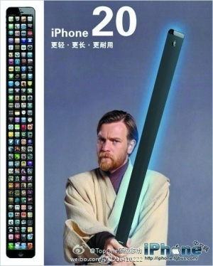
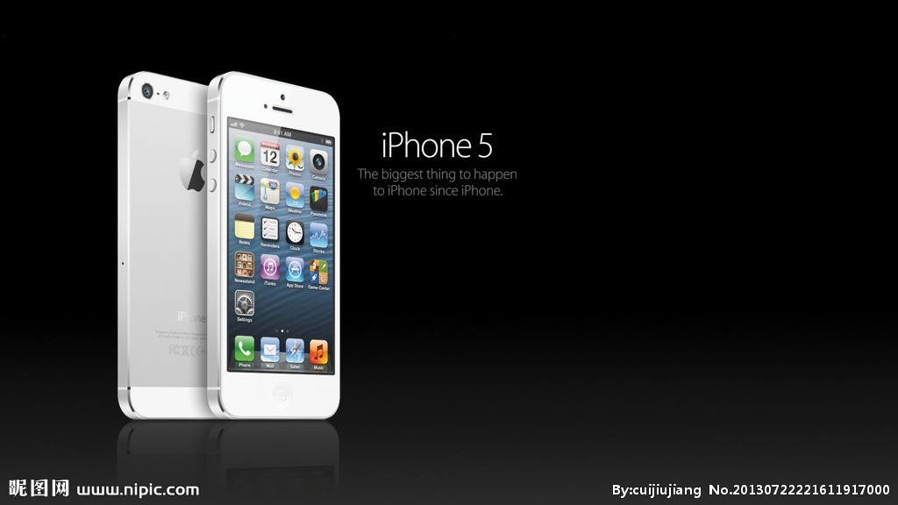

iphone5
Yes, iPhone5 has finally become longer. The size of the screen has finally increase to 4 inch. So, someone thought that the the iPhone 20 would be that one.

Slide 8
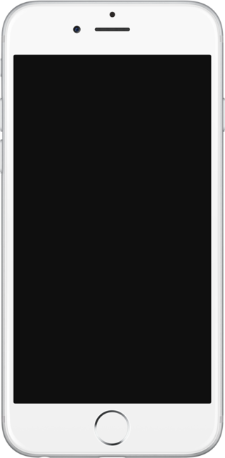
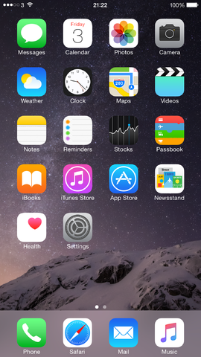
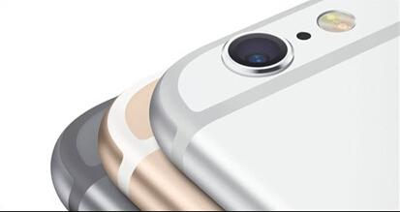
iphone6
Bigger And Bigger.
The size of the screen increase to 6/6.5 inch. It also has a thinner body (about 6.9mm/7.1mm) This creates a problem–the Protruding camera.
the Protruding camera

Slide 9
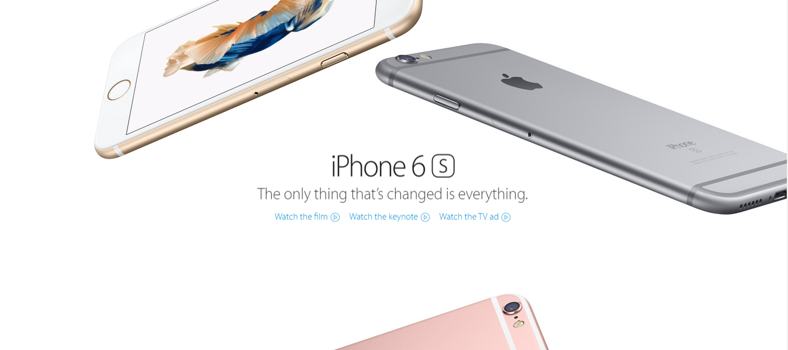
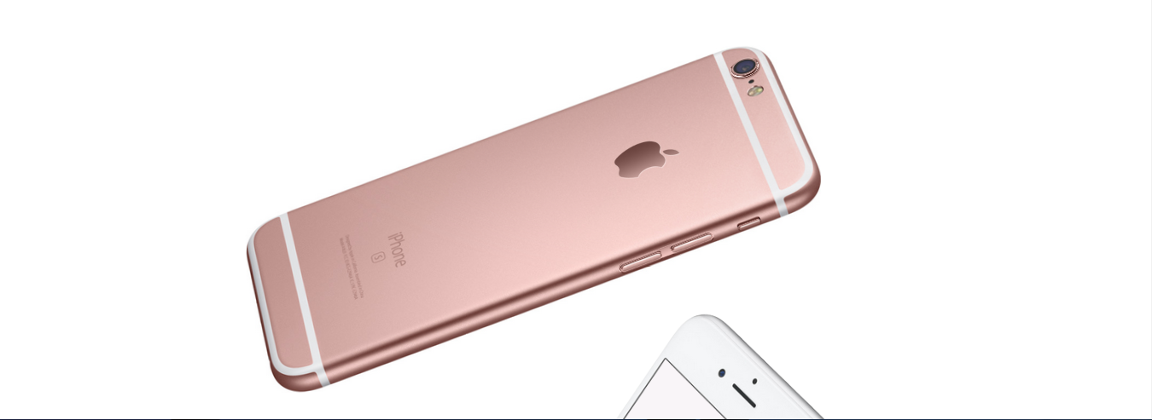

Slide 10
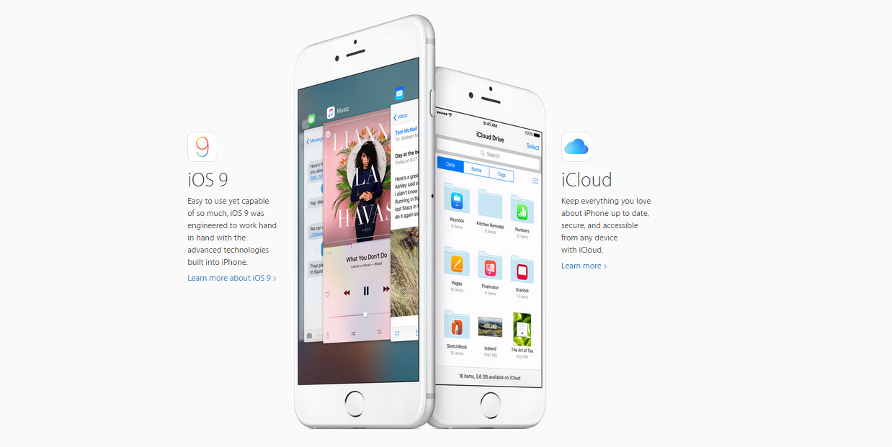
Compare to iPhone 6, iphone6s not innovative in appearance. It is only a faster iphone6 with force touch, IOS9 and so on.

Slide 11
Now let’s watch a vedio of that.

Slide 12
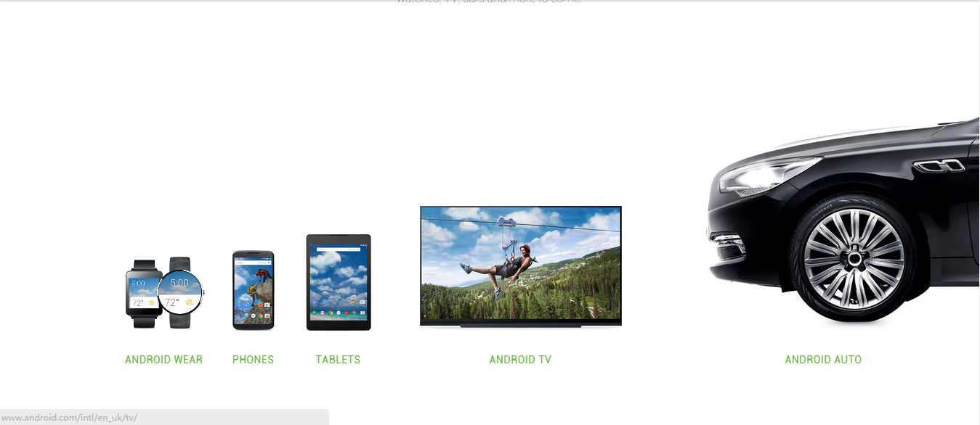
Now Let’s Come to Android

Slide 13
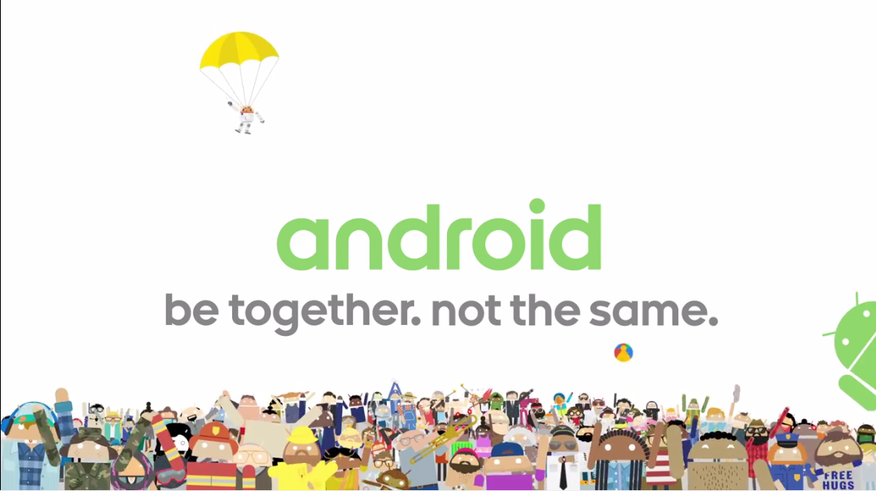

Slide 14
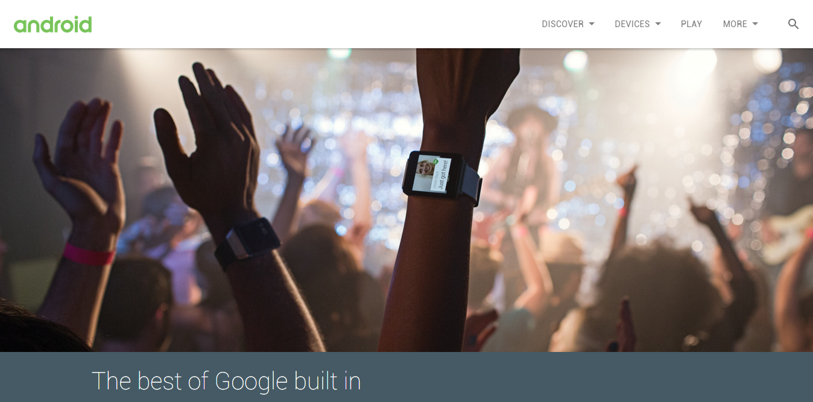


Slide 15
Android is a mobile operating system (OS) based on the Linux kernel and currently developed by Google. It is designed primarily for touchscreen mobile devices such as smartphones and tablet computers, with specialized user interfaces for televisions (Android TV), cars (Android Auto), and wrist watches (Android Wear).

Slide 16

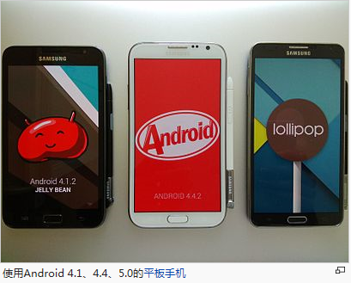
Android
Android is a mobile operating system (OS) based on the Linux kernel and currently developed by Google. It is designed primarily for touchscreen mobile devices such as smartphones and tablet computers, with specialized user interfaces for televisions (Android TV), cars (Android Auto), and wrist watches (Android Wear).

Slide 17
Google also has its official android devices: Google Nexus.

Slide 18
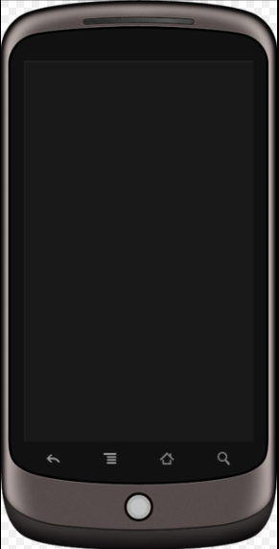
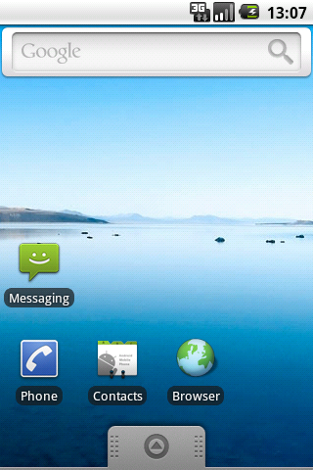
Nexus 1
The Nexus One (codenamed HTC Passion)[9] was an Android smartphone designed and manufactured by HTC as Google's first Google Nexus smartphone. The version of the android is 2.1

Slide 19

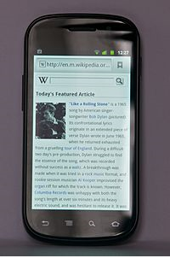
The Nexus S, manufactured by Samsung, was released in December 2010 to coincide with the release of Android 2.3 Gingerbread.

Slide 20

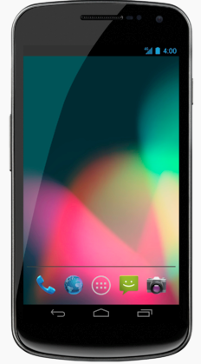
The second nexus phone that made by Samsung. By the way, it is the first phone that used android 4.0(ice-cream sandwich)

Slide 21

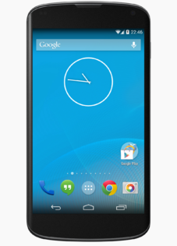
The Nexus 4 (codenamed Mako[11] or Occam[5]) is a smartphone co-developed by Google and LG Electronics that runs the Android operating system. It is the fourth smartphone in the Google Nexus series.

Slide 22

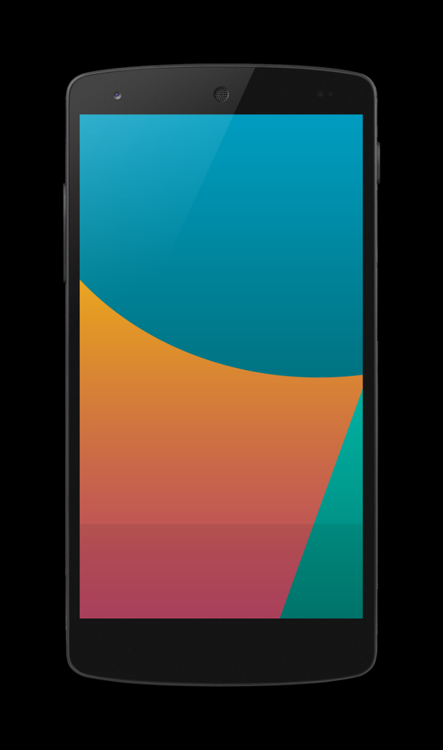
Nexus 5 (codenamed Hammerhead)[12] is an Android smartphone manufactured by LG Electronics. Co-developed with and marketed by Google Inc.

Slide 23
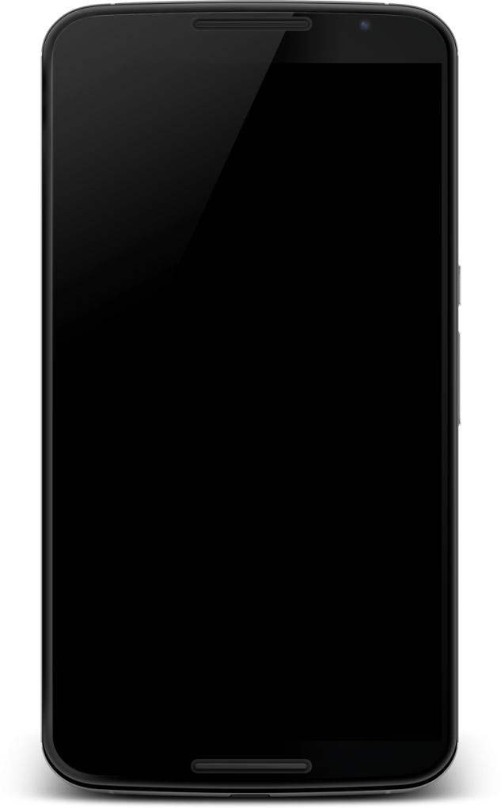
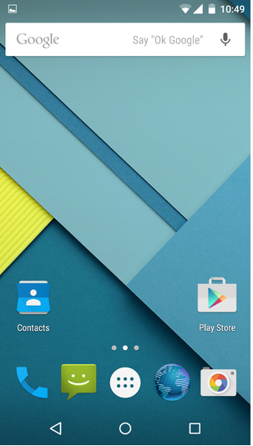
The Nexus 6 (codenamed Shamu) is a phablet co-developed by Google and Motorola Mobility that runs the Android operating system. The successor to the Nexus 5.

Slide 24
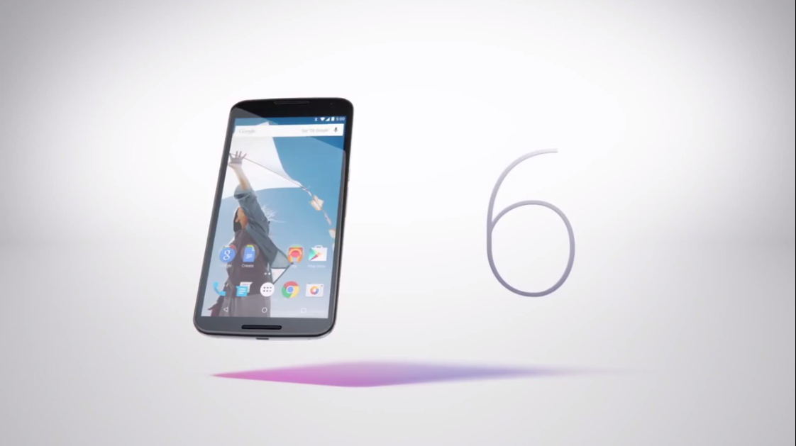

Slide 25
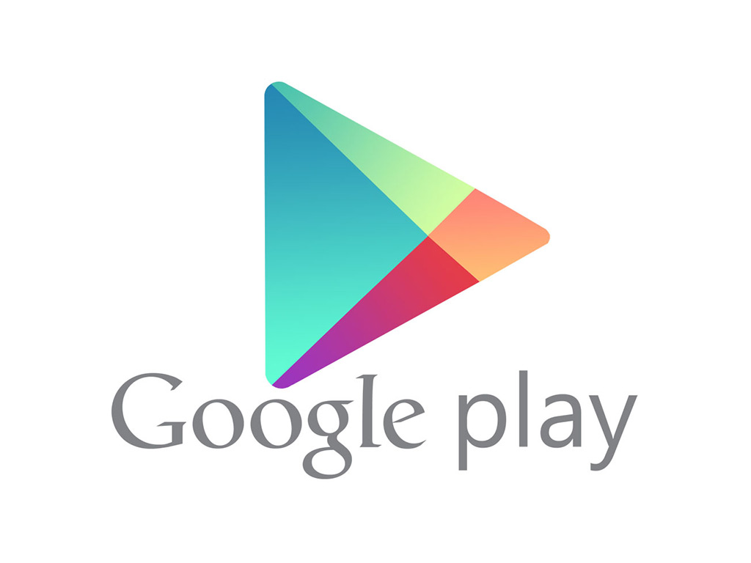
What’s more, android has many open-source such as miui, H2os, CyanogenMod and so on. It is really a fantastic system.

Slide 26
But, every coin has two sides. They both has their advantages and disadvantages. For example, iphone could not use the Third-party software, and android has a serious about safe.

Slide 27
AND,
IOS and Android are both great systems. They penetration(渗透进了) in every part of our live. We almost can not do anything without them. I can’t imagine a life without the smartphones.

Slide 28
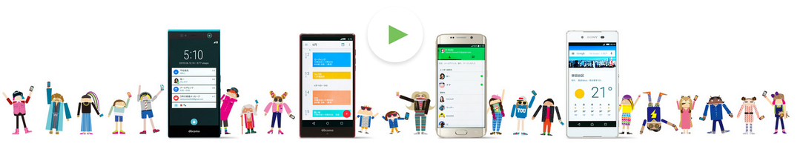
The End

Slide 29
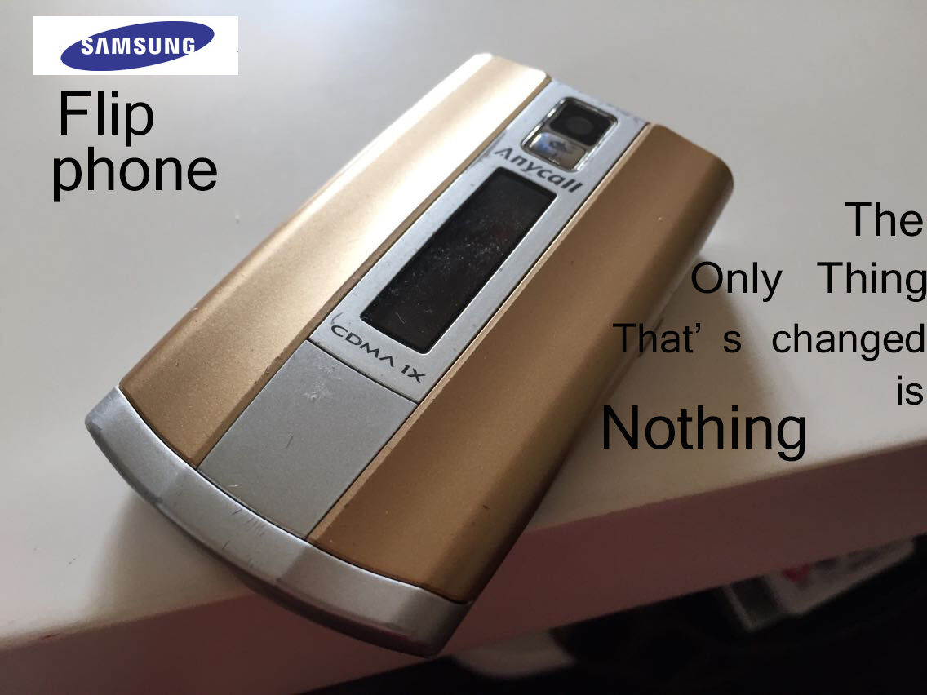
One More Thing…

Slide 30
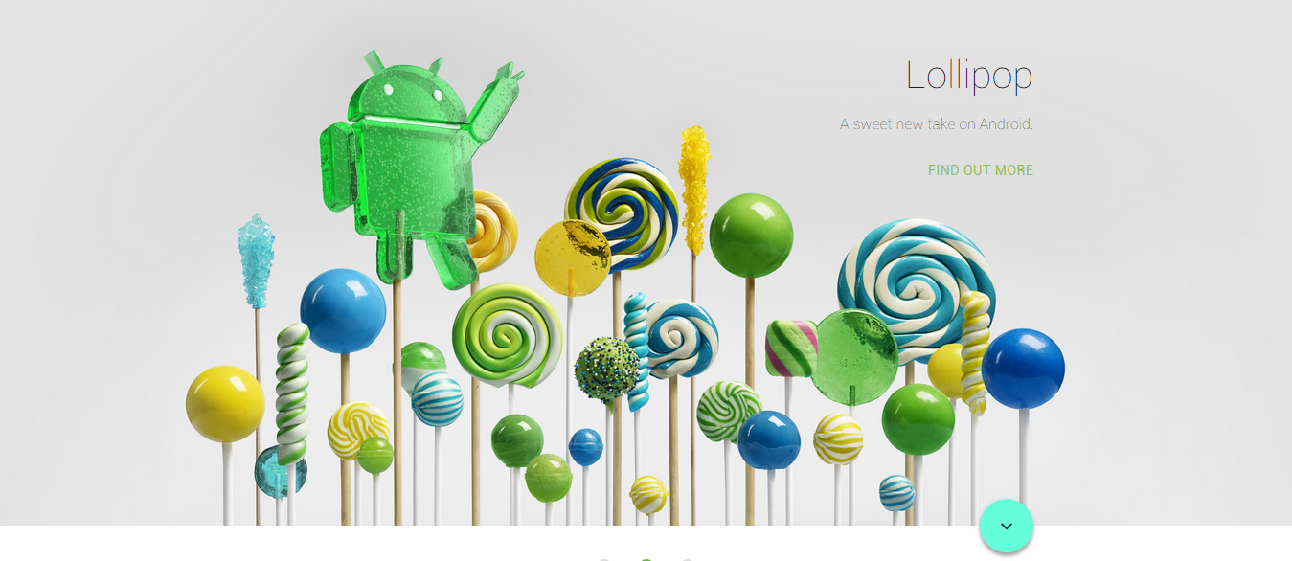
The Real End

